Slide 1

Wrap Up
Week 7, Summer 2024. 8/1 (Thurs)
Lecture 25

Slide 2
Announcements
"Official" course evaluation survey released
https://course-evaluations.berkeley.edu/Berkeley/
Filling this out will be a huge help for the Data/DSUS department with regard to course development, so please fill this out :)
Project02 ("Ants") due tonight (8/1)!
Ed post: "What's Left in C88C?"
Reminder: "clobber" policy for final exam vs midterm

Slide 3
Announcements: Final Exam
Final exam "primary" time: Wednesday August 7th, 3PM – 5 PM PST
Final exam scheduling form released
Gradescope: "(Urgent) Final Exam Scheduling"
Due: Wednesday July 31st 11:59 PM PST
Please fill this out ASAP! For more info, see Ed post.
DSP students: you should have received an email for a separate Final exam scheduling form. Please fill this out – if you didn't receive an e-mail, let us know!
Final exam will have the same style as the Midterm
Zoom+Gradescope

Slide 4
Is Your Brain Full Yet?
Data: values, literals, operations,
Functions
Variables
List, Tuples, Dictionaries
Function Definition Statement
Conditional Statement
Iteration: list comp, for, while
Lambda function expr.
Higher Order Functions
Higher order function patterns
Map, Filter, Reduce
Recursion
Abstract Data Types
Mutation
Class & Inheritance
Exceptions
SQL / Declarative Programming

Slide 5
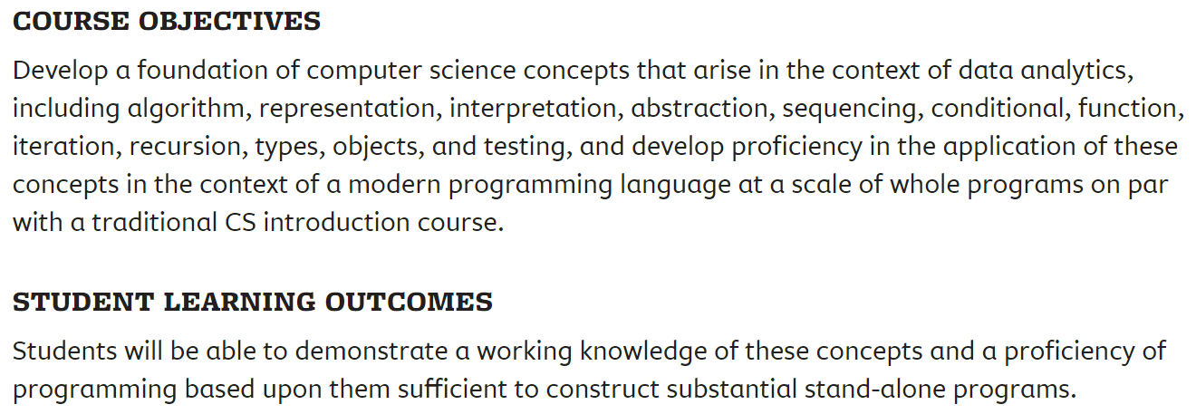
Data C88C: Course objectives
Data C88C su24: https://classes.berkeley.edu/content/2024-summer-data-c88c-001-lec-001

Slide 6
LOTS of Courses to Follow Up! [Courses]
Explore all the DS connectors
Data 88E (Econ)
Stat 88 / DATA C88S
Data 100: Principles of DS
Data 101: Data Engineering
Data 102: Data, Inference, and Decisions
Data 104: Human Context and Ethics
Data 140: Probability
INFO – Course Schedule Varies!
INFO C103 in Spring: "History of Information"
Some Database courses, web development, etc.

Slide 7
CS Courses
CS61B: (conventional) data structures, statically typed production languages.
CS61C: computing architecture and hardware as programmers see it.
CS70: Discrete Math and Probability Theory.
CS170, CS171, CS172, CS174: “Theory”—analysis and construction of algorithms, cryptography, computability, complexity, combinatorics, use of probabilistic algorithms
CS161: Security
CS162: Operating systems.
CS164: Implementation of programming languages
CS168: Introduction to the Internet
CS160, CS169: User interfaces, software engineering
CS176: Computational Biology

Slide 8
CS Courses Part 2
* CS182, CS188, CS189: Neural networks, Artificial intelligence, Machine Learning
CS184: Graphics
CS186: Databases
CS191: Quantum Computing
CS195: Social Implications of Computing
EECS 16A, 16B: Designing Information Systems and Devices
EECS 126: Probability and Random Processes
EECS149: Embedded Systems
EECS 151: Digital Design
CS194: Special topics. (e.g.) computational photography and image manipulation, cryptography, cyberwar.
Plus graduate courses on these subjects and more.

Slide 9
EE Courses Are There Too
EE105: Microelectronic Devices and Circuits.
EE106: Robotics
EE118, EE134: Optical Engineering, Photovotalaic Devices.
EE120: Signals and Systems.
EE123: Digital Signal Processing.
EE126: Probability and Random Processes.
EE130: Integrated Circuit Devices.
EE137A: Power Circuits.
EE140: Linear Integrated Circuits (analog circuits, amplifiers).
EE142: Integrated Circuits for Communication.
EE143: Microfabrication Technology.
EE147: Micromechanical Systems (MEMS).
EE192: Mechatronic Design.

Slide 10
Eric Kim's favorite classes (in no particular order)
CS 61BL: sparked my love of CS and programming, taught by Prof. Colleen Lewis (great prof!)
CS 188, 189: my first AI class, taught by Prof. Klein, Prof. Russell (great profs!)
CS 161 (Computer Security): really, really fun class taught by Prof. David Wagner (great prof!)
CS 164 (Programming Languages and Compilers): Taught by Prof. Paul Hilfinger (great prof!).
History 124B ("The Recent United States: The United States from World War II to the Vietnam Era"): really great professor (Dr. Kathleen J. Frydl) that opened my eyes to, in my opinion, one of the most interesting + impactful (to today's modern world) parts of history.
Music 60, 61 ("Harmony"): Really enjoyable, memorable adventure into functional harmony, taught by Prof. David Pereira (great prof!).

Slide 11
And there's lots more to Python!

Slide 12
What can you do with Python?
Almost anything!
Webapp backends
Web scraping
Natural Language Processing
Data analysis
Machine Learning
Scientific computing
Games

Slide 13
What can you do with Python?
Almost anything! Thanks to libraries!
Don't try to memorize libraries, learn how to learn how to use them!
Webapp backends (Flask, Django)
Web scraping (BeautifulSoup)
Natural Language Processing (NLTK)
Data analysis (Numpy, Pandas, Matplotlib)
Machine Learning (FastAi, PyTorch, Keras, Tensorflow)
Scientific computing (SciPy)
Games (Pygame)

Slide 14
DS/CS is ubiquitous in today's world
The skills you'll learn in this course, and in the rest of your DS/CS degree, will be invaluable to MANY disciplines and industry+academia
Anecdote: in medicine+tech, it's easier for a DS/CS person to pick up relevant medical knowledge than it is for a doctor to pick up relevant programming/data-science knowledge.
Intersection of X + CS/DS is really exciting! Take advantage!
Health/medicine + CS/DS
Finance + CS/DS
Entertainment + CS/DS
Law + CS/DS
(the sky is the limit!)

Slide 15
Final Review

Slide 16
Approaching The Exam
Skim the topics (~1 min)
Handle the "easy"(est) questions first
Read the whole question first!
Read the text
Read the doctests!
What techniques might be applicable?
Pattern matching is OK
Draft a solution on scratch paper!
Write yourself notes

Slide 17
SQL practice: https://code.cs61a.org
For following SQL practice, we will use the `records`, `salaries` table from code.cs61a.org
# (Question) what SQL query to show, for each employee's row, their supervisor's salary? (2022 salary is fine)
select records.name, records.salary, records.supervisor, records2.salary as salarySupervisor from records, records as records2 where records.supervisor = records2.name;

Slide 18
SQL practice: https://code.cs61a.org
For following SQL practice, we will use the `records`, `salaries` table from code.cs61a.org
# (Question) which SQL query to show the salary increases from 2022 -> 2023?
select name, salary2023 - salary2022 as salaryDelta2022to2023 from salaries;

Slide 19
SQL practice: https://code.cs61a.org
For following SQL practice, we will use the `records`, `salaries` table from code.cs61a.org
# (Question) which SQL query to show each department's min, max, and avg salary?
select division, MIN(salary) as minSalary, MAX(salary) as maxSalary, AVG(salary) as avgSalary from records group by division;

Slide 20
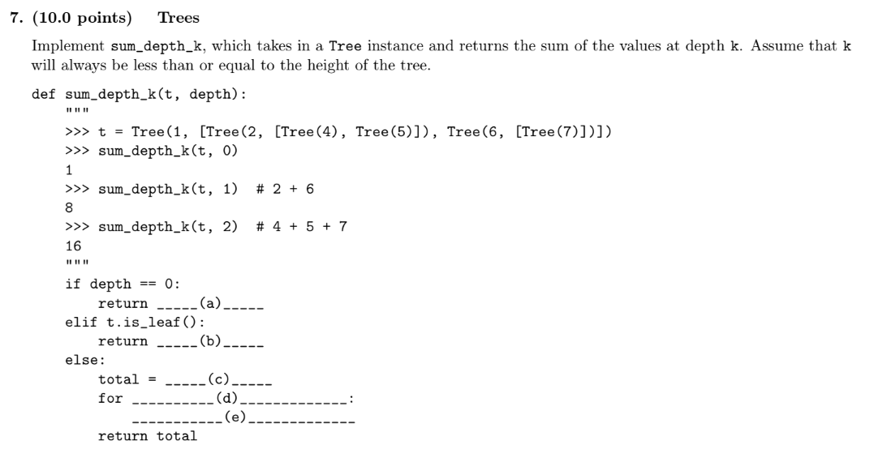
Spring 2024 – Question 7 - Trees

Slide 21
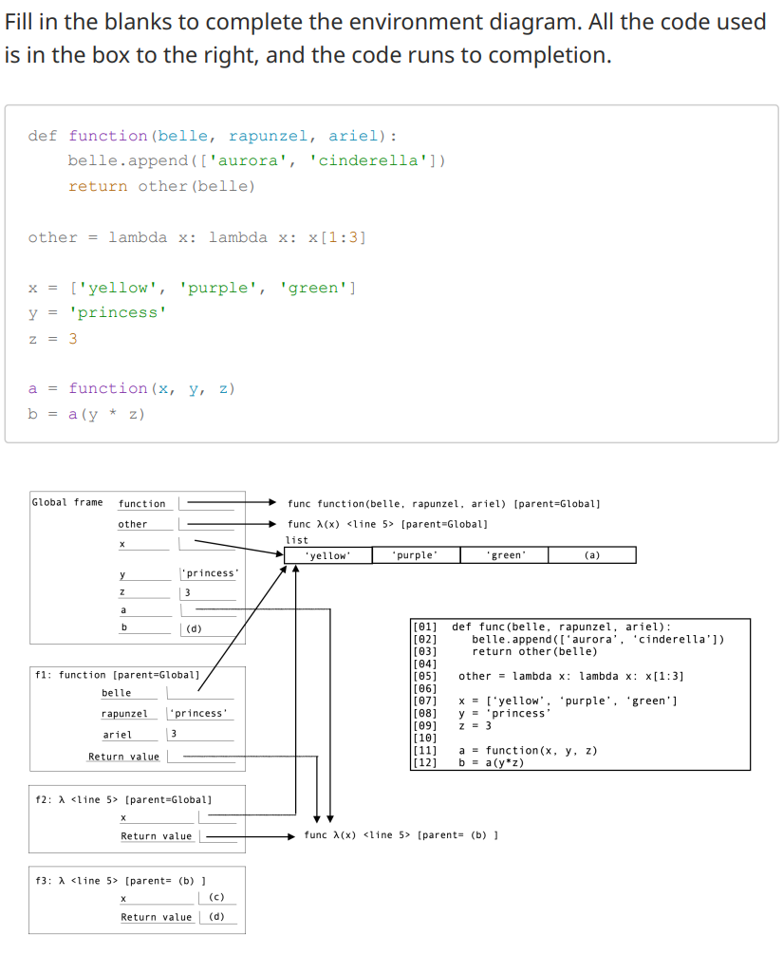
Summer 2024 Midterm: Env Diagram

Slide 22
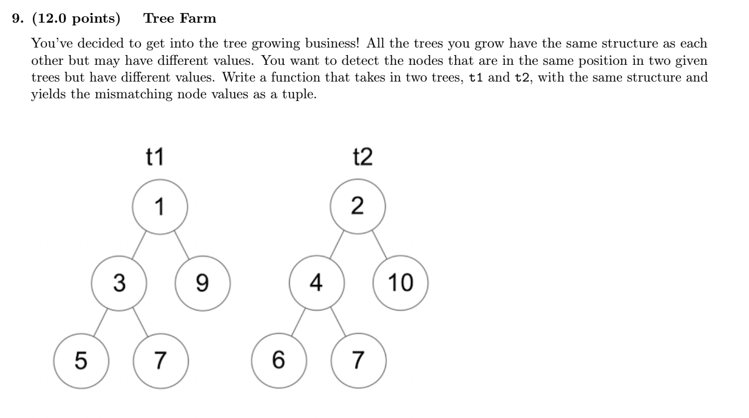
Fall 2021 Q9 – Tree Farm

Slide 23
THANK YOU!

Slide 24
COME JOIN COURSE STAFF!

Slide 25
THANK YOU!
(Again!)

